Slide 2
This exercise makes visible what is being managed in the Scrum Framework and by whom. And more importantly, what is being managed differently in an organization currently? What effects does that have on the empirical process?
Put the five roles (Accountabilities) in a row on the floor.
Invite participants to form groups and hand each group a subset of the red/green cards.
In the first round, give the group(s) time to put the cards with the role that manage the mentioned topic in Professional Scrum. Make sure that at the end of this round, the activity cards are in the right place.
In the second round, invite everyone to (individually) mark the cards that are managed differently in their organization.
Invite people to pair up and discuss what the impact of the marked cards is on the empirical process in their organization.
In the final round, identify the next steps to address these impediments.

Slide 3

Developers

Slide 5
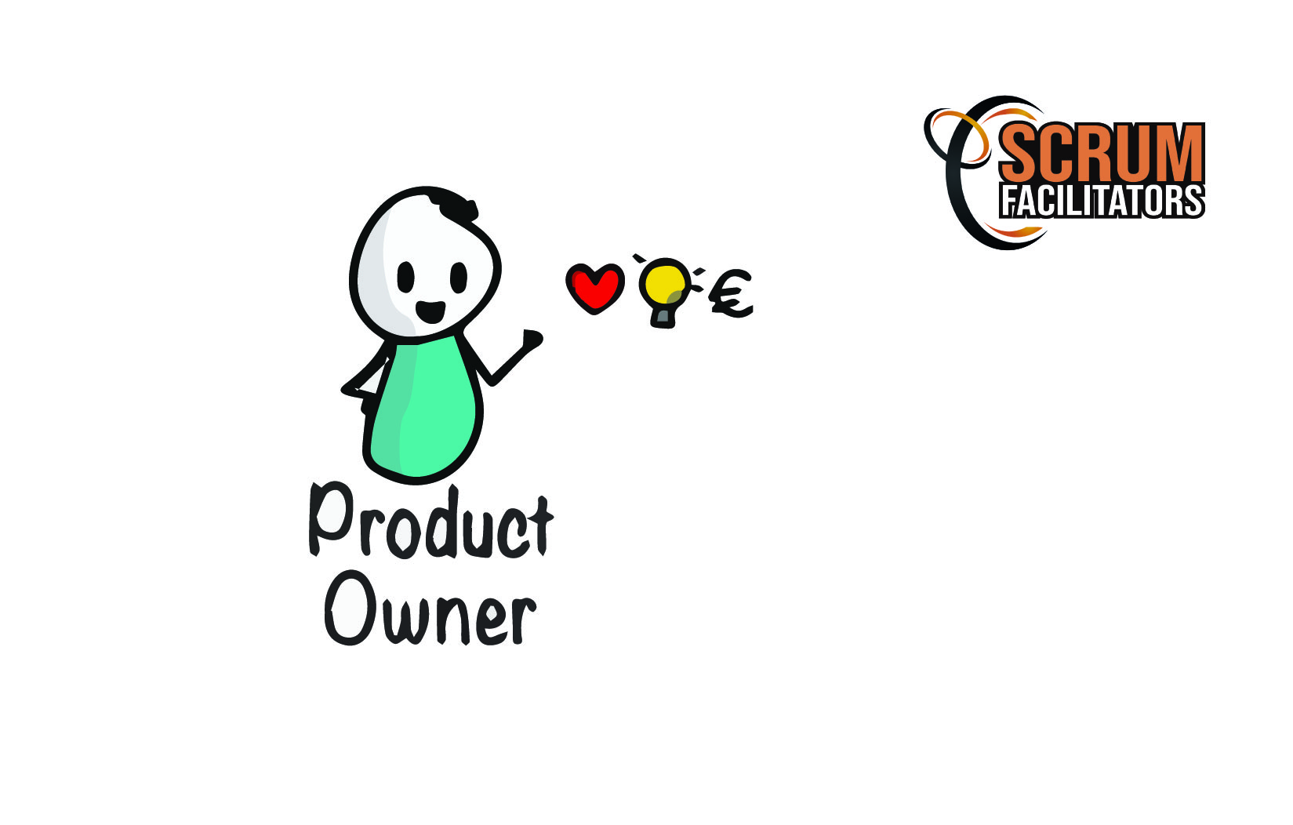
Product Owner

Slide 7

Scrum master

Slide 9
Line manager

Slide 11
Project manager

Slide 13
Customer voice

Slide 14
CUSTOMER VOICE

Slide 15
State of the increment

Slide 16
State of the increment

Slide 17
Sprint backlog

Slide 18
Sprint backlog

Slide 19
Technical Innovation

Slide 20
Technical Innovation

Slide 21
Bug

Slide 22
Bug

Slide 23
Product vision

Slide 24
Product vision

Slide 25
Product Backlog

Slide 26
Product Backlog

Slide 27
Return on investment

Slide 28
Return on investment

Slide 29
Scrum process

Slide 30
Scrum process

Slide 31
Tension in the Scrum team

Slide 32
Tension in the Scrum team

Slide 33
Technical debt

Slide 34
Technical debt

Slide 35
Velocity

Slide 36
Velocity

Slide 37
Documentation

Slide 38
Documentation

Slide 39
Personal growth
(Of the Developers)

Slide 40
Personal growth
(Of the DeveloperS)

Slide 41
Sprint backlog

Slide 42
Sprint backlog

Slide 43
impediments

Slide 44
impediments

Slide 45
Refinement

Slide 46
Refinement

Slide 47
Scope of the project

Slide 48
Scope of the project

Slide 49
Product budget

Slide 50
Product budget

Slide 51
Stakeholders

Slide 52
Stakeholders

Slide 53
Release Planning

Slide 54
Release Planning

Slide 55
Team performance

Slide 56
Team performance

Slide 57
Interaction with other scrum teams

Slide 58
Interaction with other scrum teams

Slide 59
Promoting and supporting scrum

Slide 60
Promoting and supporting scrum

Slide 61
Team morale

Slide 62
Team morale

Slide 63
Culture

Slide 64
Culture

Slide 65
Boundaries of self-management

Slide 66
Boundaries of self-management

Slide 67
Product Goal

Slide 68
Product goal

Slide 69
Team Composition
(among the developers)

Slide 70
Team Composition
(among the developers)

